Slide 1


“Tiger”
The final project
Notes:
Dorin →Dorin
הוא תאגיד רב-לאומי אמריקאי, מהחברות המובילות בעולם בתחום של תכנון וייצור מיקרו-מעבדים ומעגלים משולבים. כמו כן, אינטל מייצרת כרטיסי רשת, מערכות שבבים ללוחות אם, מוצרי תוכנה והתקנים אחרים.

Slide 2




5 team
Marina Shteinfer
Dorin Bachar
Asaf Schneiderman
Guy Stein
Notes:
Dorin→ Dorin

Slide 3
Description:
The purpose of the tool:
This tool is a wrapper for verification checks flow such as DRC,LVS etc.
This tool is to make a less complex and more intuitive for users.
Reduction in working time.
"TIGER"
Notes:
Dorin→ Dorin
סקריפט הוא מעטפת לבדיקות אימות כגון : DRC , LVS .
המטרה העיקרית של הסקריפט היא ליצור ממשק פחות מורכב ויותר אינטואיטיבי למשתמש.

Slide 4
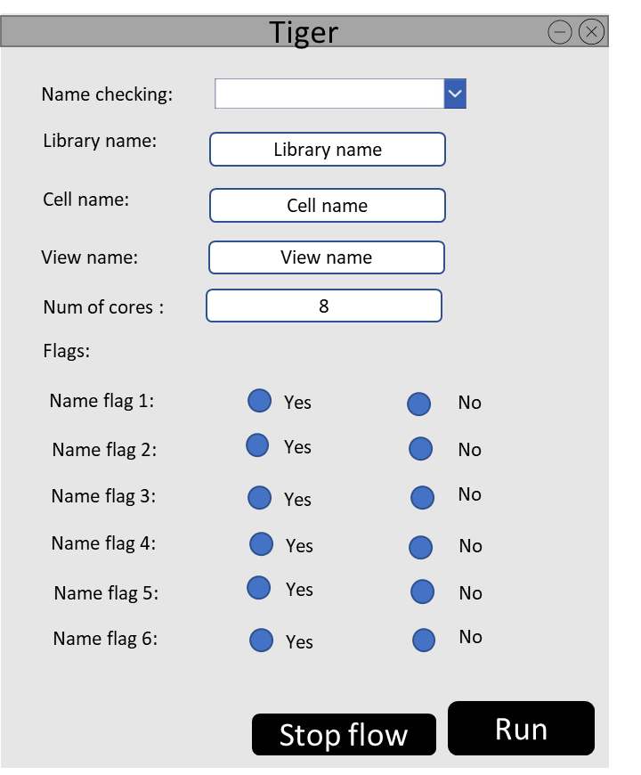
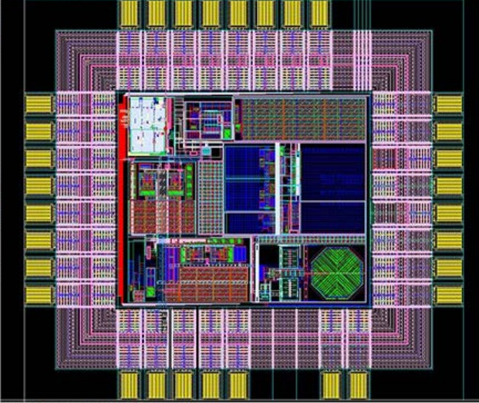
Prototype:
Notes:
Dorin → Guy

Slide 5

Part 1 : about as organization
Interview Summary:
We interviewed two people from the Intel Company (stakeholders).
First one user and initiator of the tool and programmer of the tool.
The tool is very useful, effective and contributes to the way of working.
The users use the “Tiger” on daily basis.
They want to continue to develop the tool.
There are complains that the tool doesn’t work on all the environments.
Notes:
Guy→ Guy

Slide 6
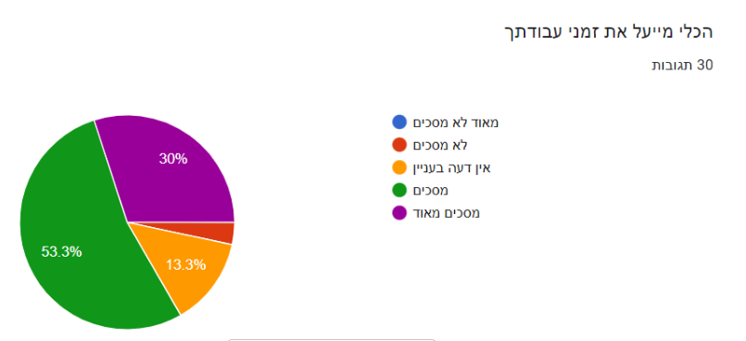
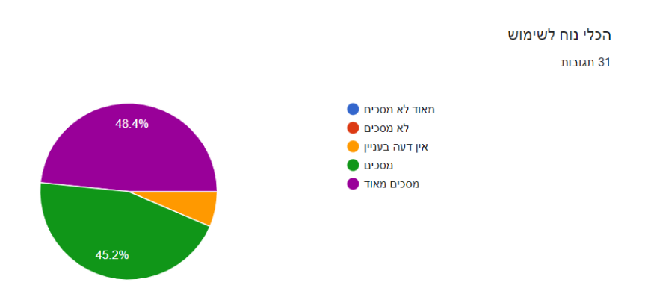
Examples from the results of the questionnaires:
Notes:
Guy → Guy

Slide 7
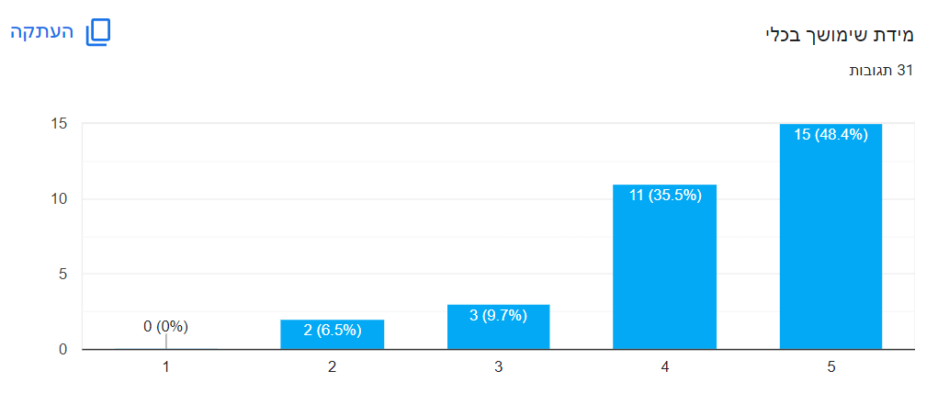
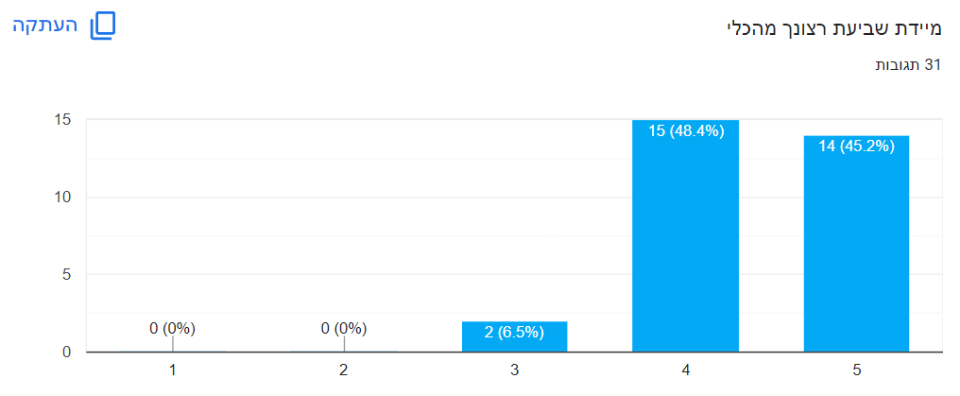
Examples from the results of the questionnaires:
Notes:
Guy → Asaf

Slide 8

Main persona
Adi, 35.
Background: Practical Electronic Engineer works for Intel as project manager.
Description: Adi is interested in gadgets and new technology that is constantly improving and advancing. In addition, he admires the characters of the "Marvel" films. He finds problems and incorrect ways of working and initiates ideas to improve his and his team members' working way save time. He initiated the development of the "Tiger" tool.
Notes:
Asaf → Asaf

Slide 9
The primary MOV of the project :
Statement | timeframe | matric | Area | NFR | FR
The project will be successful if the tool will reduce the time of typing a command by 80%. | Developing time will be 6 weeks (3 sprints) After a month there will be improvement in users' performance and projects will be completed in time or before the deadline . | Shortening work time Prevention human errors while typing the command . | Time Financial | Pressing the “Run” bottom creates the command without errors. | The tool creates a testing command.
The project will be successful if the number of users in the tool will more then 30 per day. | In a month there will be more users using the tool. | The number of users in the tool The number of login to the tool. | Organizational |  | The tool allows to display a report of the number of uses in “Tiger”.
Notes:
Asaf → Asaf

Slide 10
part 2: Organization requirements and initial architecture
The initial architectural model:
Event-driven architecture.
Since the user enters details so the test to be performed and presses the "RUN" button when he wants to perform the test or “stop flow” button when he wants to stop the test, therefore it is important to respond to events when entering the parameters and clicking.
Description | SOA principles
Service hide the logic from the outside world. it is often dropped as a principle. | Service abstraction
Service break the big problem into smaller problems. Each server runs a different test. | Service Composability
Services should use standards that allow diverse subscribers to use the service. Our tool is used by users from all over the world. | Service Interoperability
Notes:
Asaf → Marina

Slide 11
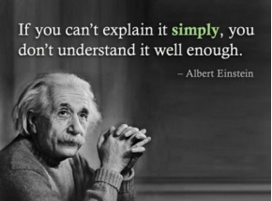
Functional requirements
The tool can run a test command.
The tool can insert parameters for the test.
The tool can click the buttons in the GUI.
The tool can stop the test in the middle.
The tool creates a test command.
The tool creates a test results report.
The tool displays a message at the end of the test.
The tool displays a report of the number of uses of the system.
Notes:
Marina -> Marina

Slide 12

Non-functional requirements
The parameters are selected from a built-in database. (Backup)
The parameters are: name of the test to be performed, selection of "flags" suitable for the desired test. (usability)
The buttons in the GUI are: "Run" which creates the command line and runs the test, "stop flow" stops the test in the middle. (Operability)
The test results report shows if there are errors in the test for the scheme or if everything went successfully. (Reporting)
Ending message of the tool including the name of the test, the name of the layout file on which the test was performed. (Data integrity)
The tool is adapted to different work environments. (Adaptability)
Notes:
Marina → Marina

Slide 13
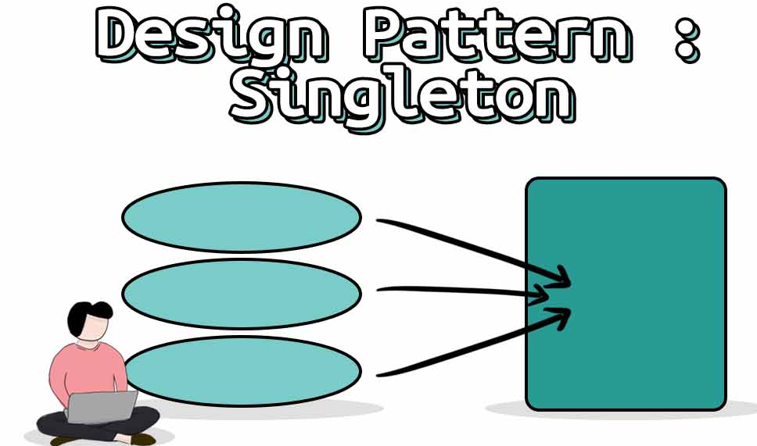
Design patterns
singleton- running the same checking command multiple times by several user
adapter- different information will be displayed in the results report when the “layout” file isn’t the same.
Notes:
Marina → Marina

Slide 14
Risks table :
Effect | Probability | Type | The risk
tolerable | Medium | People | The staff will refuse to work with the tool and they will want to work the old way.
tolerable | Low | People | Departure of a programmer during development.
catastrophic | Low | Technology | Many will report about the problems with the tool.
Serious | Medium | Technology | There will be no adaptation of the tool to the work environment.
tolerable | Low | Tools | Users will ask for another tool that will be faster.
catastrophic | Low | Organizational | Management will regret developing the tool in the middle of development.
Serious | Low | Estimational | The tool will not be ready with a deviation of 30% or more from the planned.
Serious | Medium | Estimational | Failure to meet troubleshooting deadlines.
tolerable | Medium | Requirements | Requirements of the tool may change during development.
Notes:
Marina → Dorin

Slide 15
Risks table for Technical debt:
Solution 2 | Solution 1 | Technical debt | num
 | Release the appropriate tool for a work environment where most of the group members work and then later update to the new environment. | Pressure from the users to release the tool so that they can work with it and promote projects, but in practice there may be a situation where we get a tool that does not work in all work environments. | 1
Updating the tool for additional tests (existing and new). | Users will be able to perform partial checks on the file. | Lack of conformity to the standards that the users expected For example: not all the names of the tests appear. | 2
 | When building the tool try to cover as many edge cases as possible. | Lack of a test suite for the tool that can prevent bugs. | 3
Notes:
Dorin → Dorin

Slide 16
Risks table for Technical debt:
Solution 2 | Solution 1 | Technical debt | num
Provide more processors that they can run the test and then it will run faster. | Dealing with user support and trying to improve the tool by making a transition of writing the tool in a uniform language or optimizing the code. | Lack of understanding of the tool's development needs and the difficulties during its development, for example: developing the tool in several programming languages, which causes the tool to slow down | 4
 | Going over the code and documenting the code in the critical sections that are usually modified such as: adding the name of the test and flags. | A lack of code documentation creates a problem when the developer of the tool is no longer present in the company and then the code must be understood, which takes time and difficulty. | 5
Notes:
Dorin→ Dorin

Slide 17
Testing table:
Expected result | Manual/ automated | Type (unit/ component/ system/ acceptance) | Description | number
Displayed an error message to the user: “The file in view name isn’t of layout type ”. | automated | system | Entering invalid parameters such as the file in view name isn’t of layout type. | 1
Displayed an error message to the user: “The number of cores is incorrect ”. | automated | unit | Entering invalid parameters such as the number of cores is incorrect,i.e too high or too low. | 2
Open error window: “please, open “layout” file”. | automated | system | opening of the tool without the “layout” file open. | 3
Expect to see the error in the results report. | automated | acceptance+ system | Insert an error in the “layout” file. | 4
A log file will be opened which shows a report of the results of the checking at the end. | automated | unit + acceptance | pressing a “Run” button. | 5
The tool will stand loaded and work as usual. | automated | system | testing the load of the tool by using the tool with several users at the same time. | 6
A message window opens: “The test stopped in the middle” | automated | unit | pressing a “stop flow” button. | 7
Notes:
Dorin → Guy

Slide 18
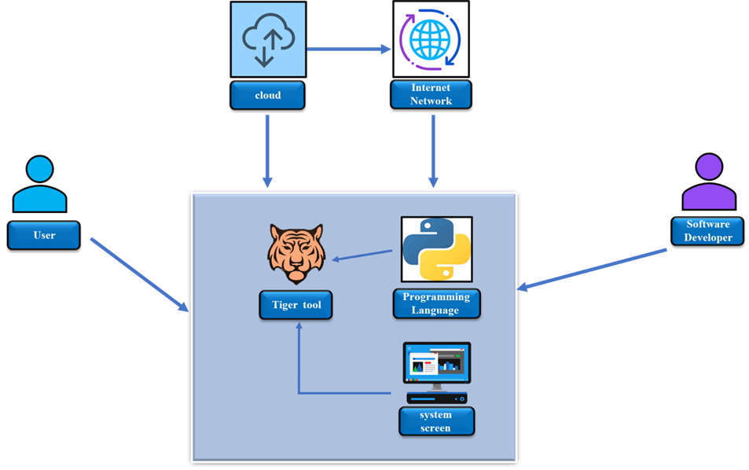
Part 3: Distributed cognition and motivation
Notes:
Guy → Guy

Slide 19
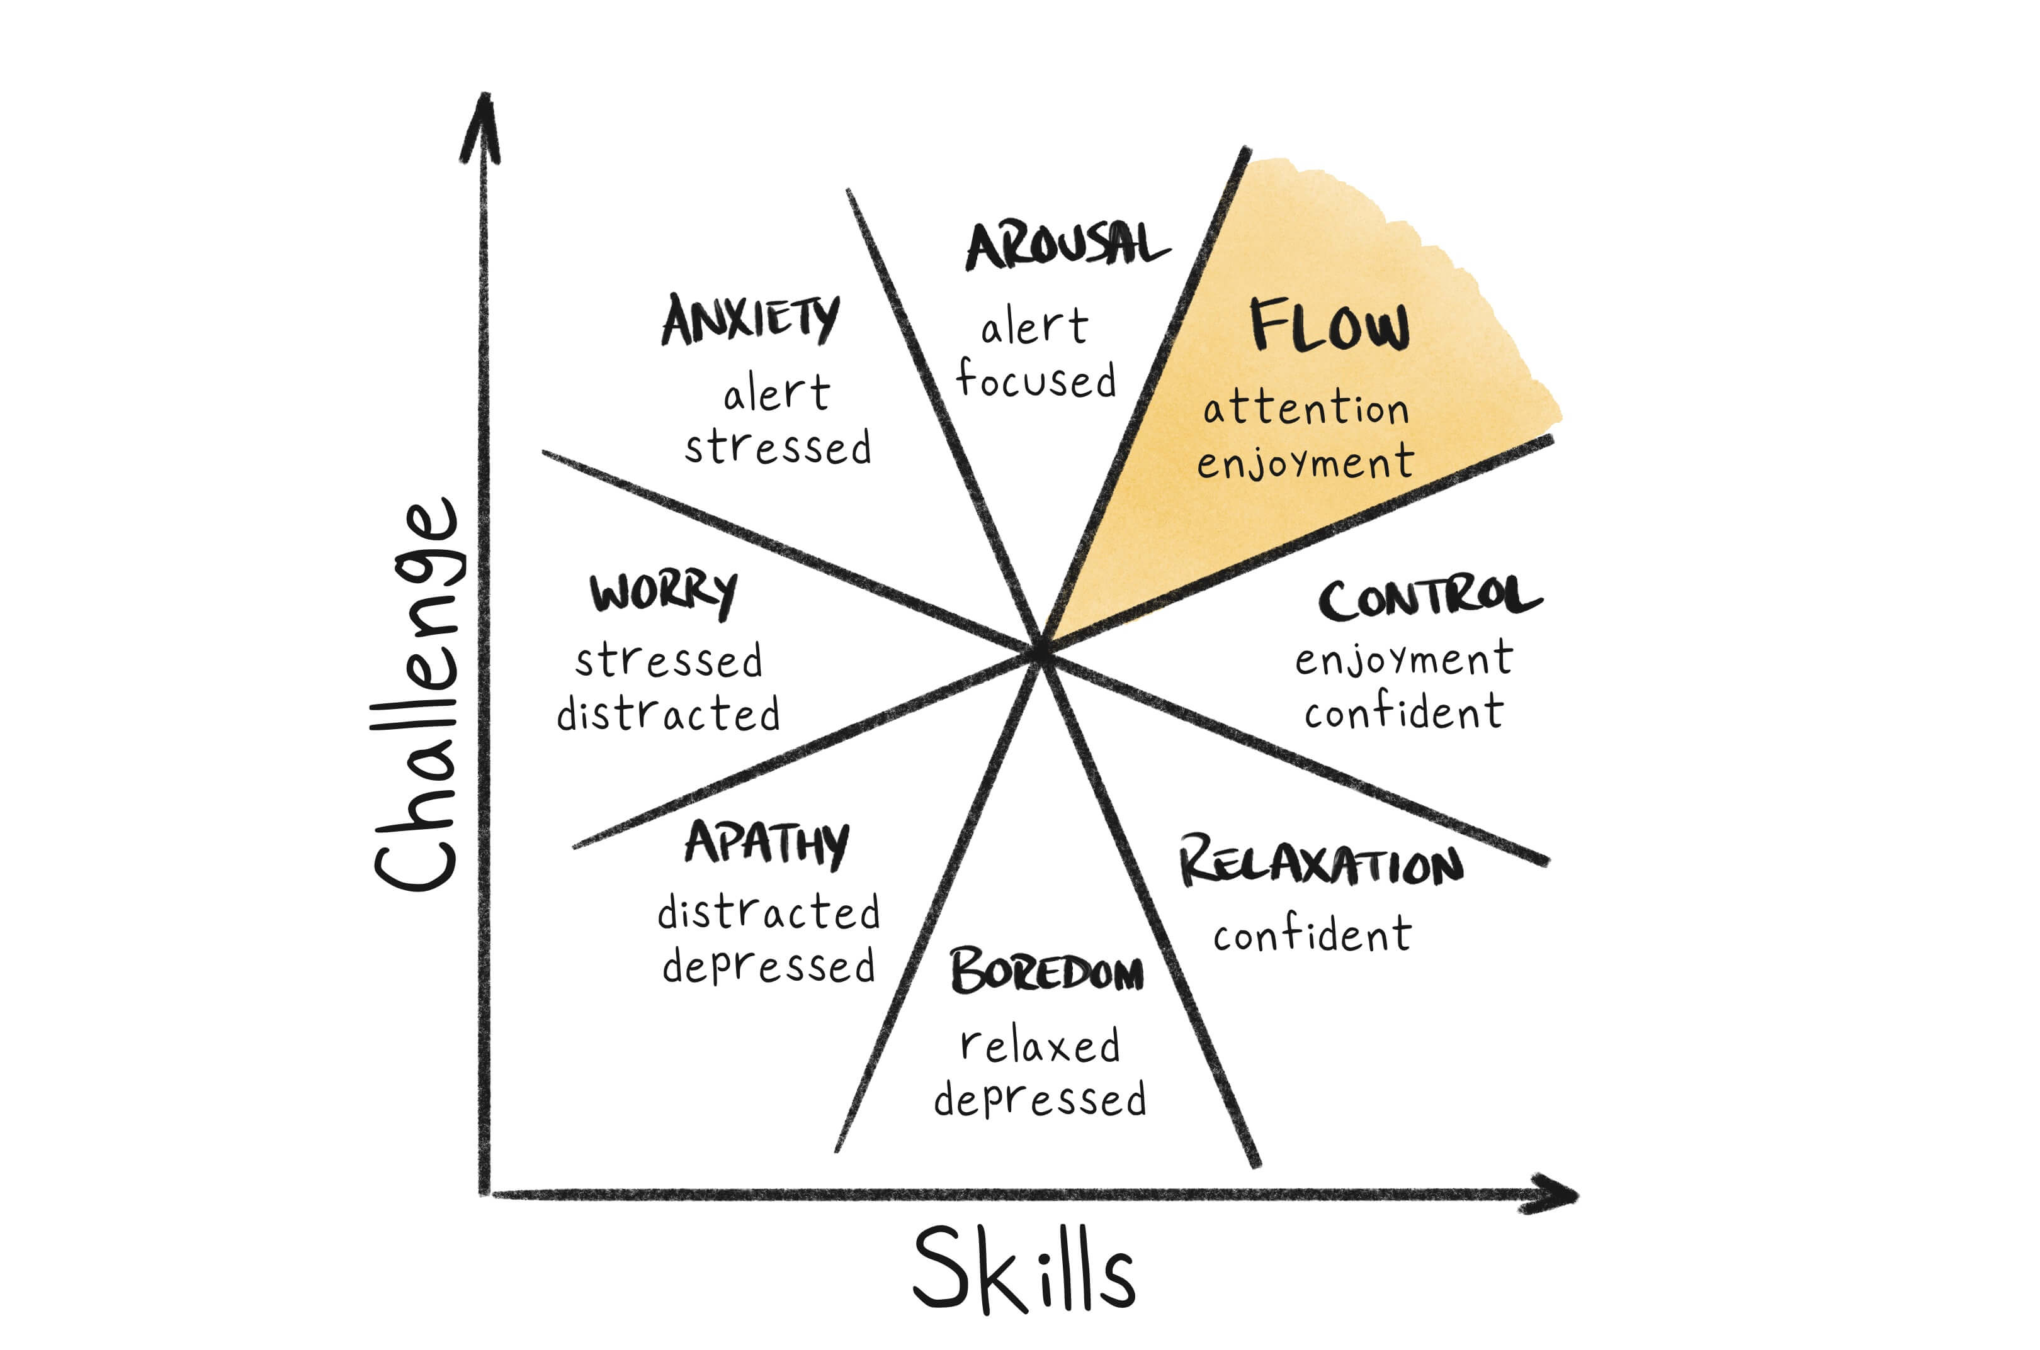
Flow characteristics:
Concentration - The tool is in one window so the user's concentration is focused on one screen and he doesn't need to switch windows.
Challenge - Choosing the name of the test to run and dealing with the result report.
User skills - The users of the tool should be familiar with the tests and their purpose, for example, the Layout designer.
Control - The user can choose the test to run and the file on which the test is performed.
Clear goals-The clear goal is to run the test on the file and get a results report.
Immersion- Following the results of the questionnaires filled out by the users, the process of assimilating the tool into the system was successfully carried out for the users.
social interaction- other users can check someone else’s files and help them to understand the error shown in the result report.
Notes:
Guy → Guy

Slide 20
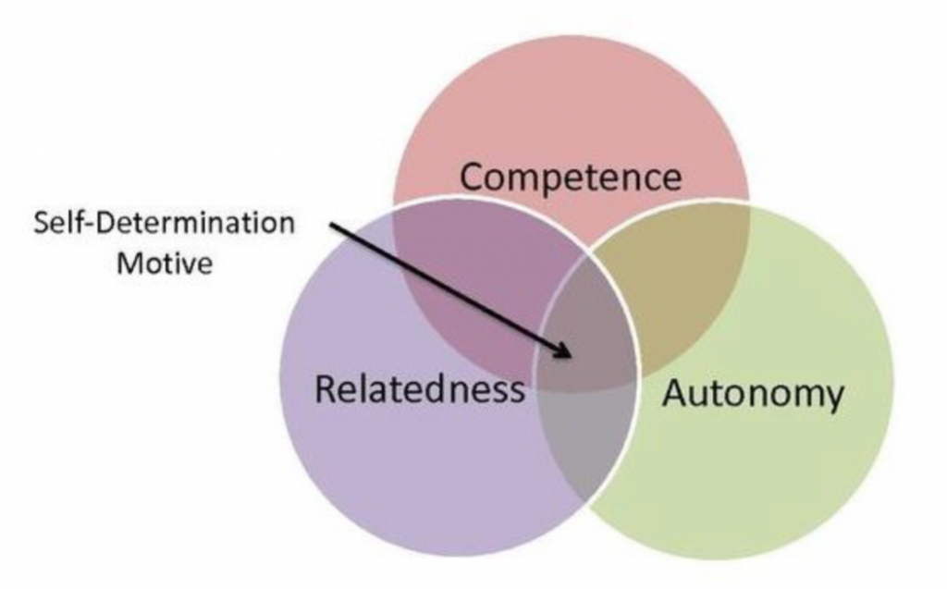
SDT (self-determination theory)
Competence - Users feel competent when the results report is without errors or when there are errors they know how to deal with.
Autonomy - The user can choose the test to run and the file on which the test is performed.
Relatedness - other users can check someone else’s files and help them to understand the error shown in the result report. In addition, the desire to finish the test in a faster way and meet the team’s deadline.
Notes:
Guy → Asaf

Slide 21

Gamification :
Scoring - displaying a scoring table for the top users who have the fewest errors when running the tests. The table will cause recognition and appreciation for the employees and will stimulate competitiveness among the employees.
Badges - receiving badges based on use with the tool, the more you use the tool, the more badges will increase. Designed and advanced badges will indicate that employees are more experienced in working with the tool, which may motivate them to make many uses of the tool and help other employees in working with the tool, because they are already labeled as "experts" in working with the tool in the system.
Survey/Rating - Receiving the opinion from the users about the tool by conducting a survey or rating of the tool, which is a pop-up window requesting to make a rating/opinion for the use of the tool.However, this abrasive may be distressing for the user as it may impair the continuity of work with the tool in the system.
Notes:
Asaf → Asaf

Slide 22

Challenges during the working process:
Synchronize our schedules.
Disagreements between group members.
Lack of time.
To get users to answer the questionaries.
Notes:
Asaf → Asaf

Slide 23
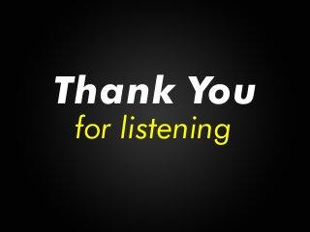

Slide 24
Reference :
https://www.ic-cracker.com/integrated-circuit-layout-design-function/
https://forms.gle/zLmChgwCPZnr6yHr8
https://en.wikipedia.org/wiki/Intel
https://www.methoda.cloud/?section=254#section-24
https://migdala.com/%D7%97%D7%A9%D7%99%D7%91%D7%94-%D7%A2%D7%99%D7%A6%D7%95%D7%91%D7%99%D7%AA-%D7%90%D7%99%D7%9A-%D7%96%D7%94-%D7%A2%D7%95%D7%91%D7%93/

